Slide 1

MarketingAI
Next semester marketing posters

Slide 2
Goal
A software application that allows users to input specific themes or topics for a meme or propaganda poster. Following this input, the application should be capable of autonomously generating relevant imagery and accompanying text. Subsequently, it should seamlessly integrate these elements to produce a cohesive poster

Slide 3
Technologies used

Slide 4
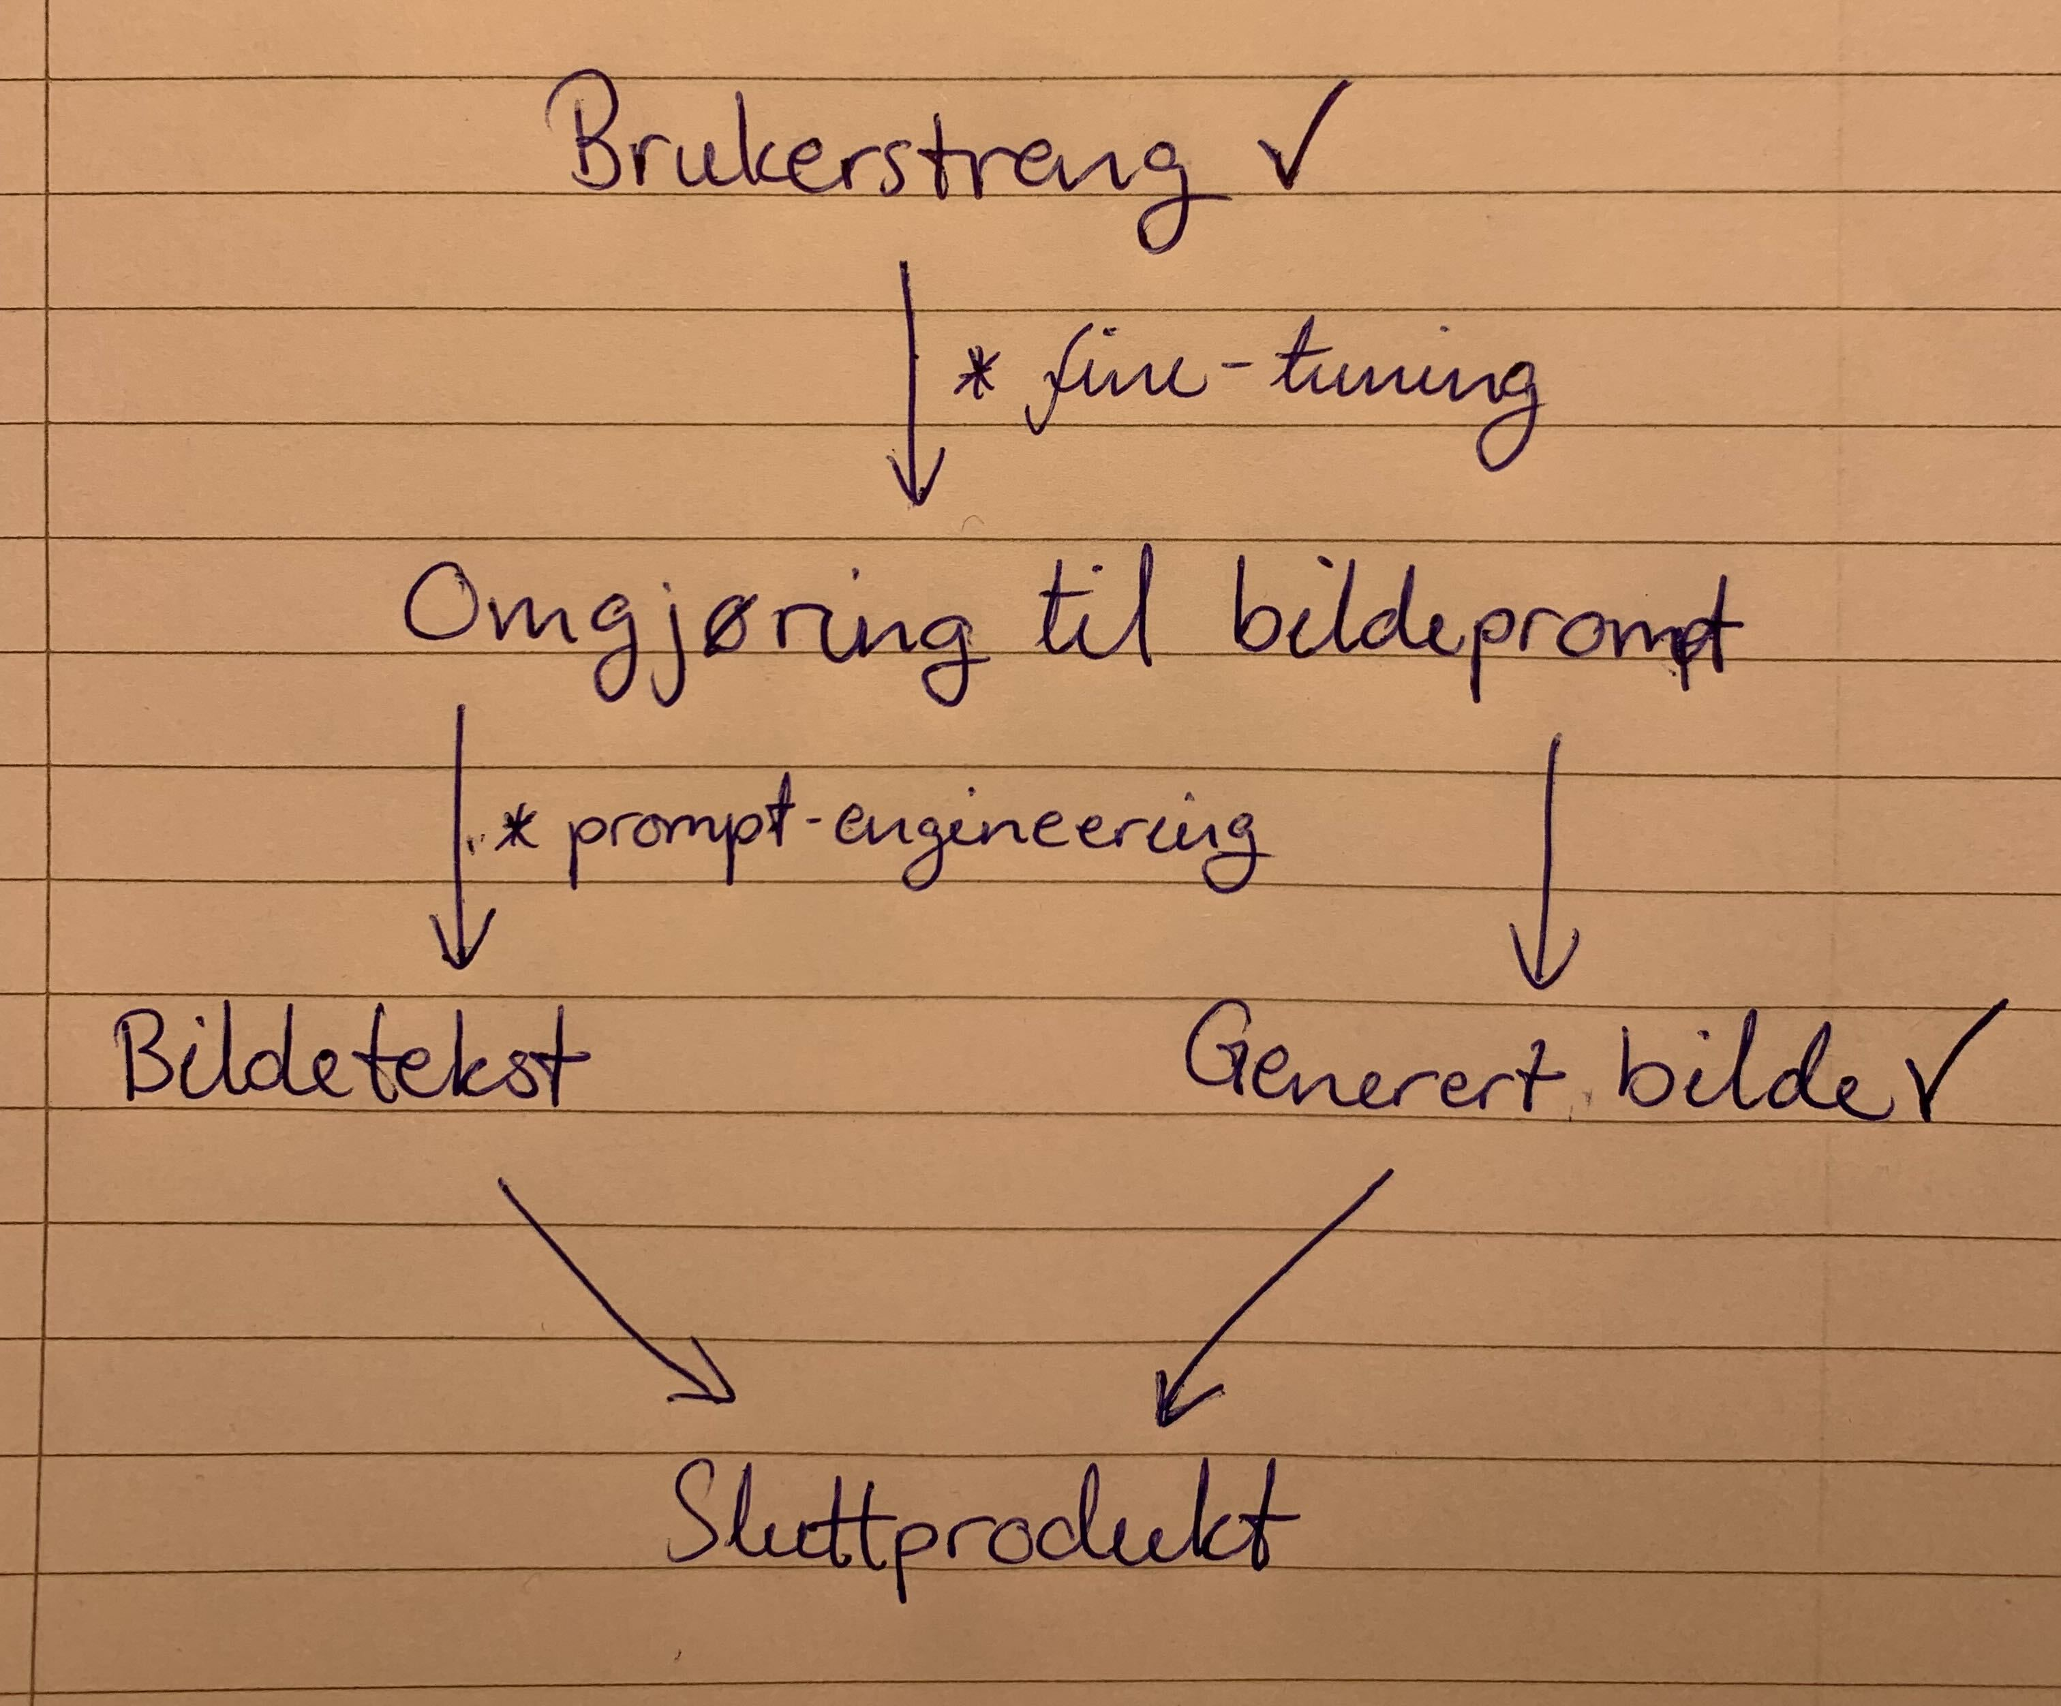
Systems overview

Slide 5
Achievements
User input
Integrated application with image and text generation technologies
Configuration and safe storing of API keys
Logging for observability
Image and text caption assembling
Created tests and CI system
Good documentation such that non group members manage to set it up and run use it
Good pipeline and easy setup
Stated to create our own dataset for propaganda posters to finetune
Create more prompt templates for:
Propaganda, Meme and Marketing
Improve templates with prompt engineering
Gather more good prompts for finetuning
Create an “Auto Style” functionality
Use function calling to help in styling image caption
Create a frontend application using MarketingAI and add it to the cogito website ☺

Slide 6

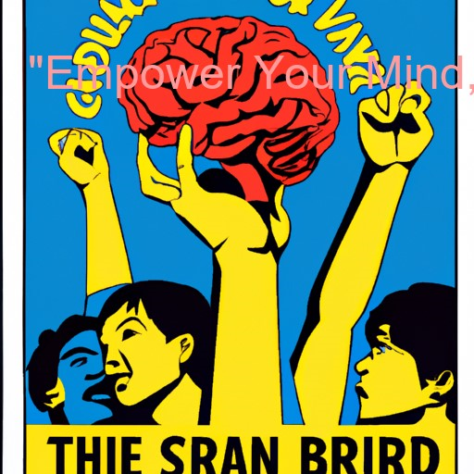

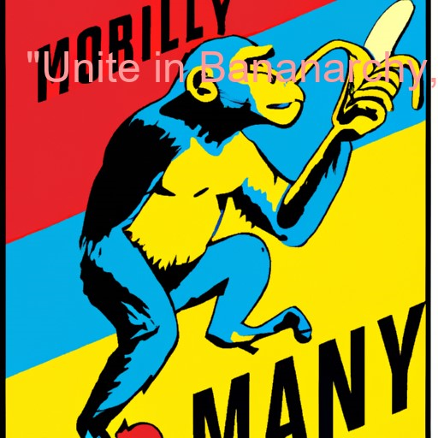
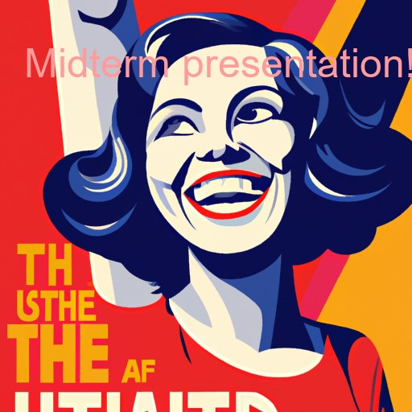
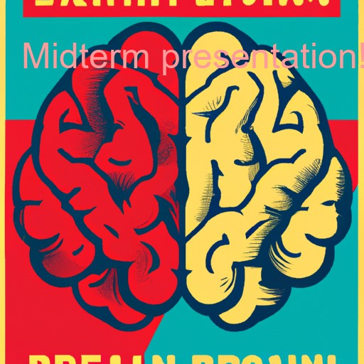
Midterm image production

Slide 7
Final image Production

Slide 8
Hurdles and how we overcame them

Slide 9
It is said that a picture is worth a thousand words
Tell the story about the image generator dies immediately if we give it that much

Slide 10
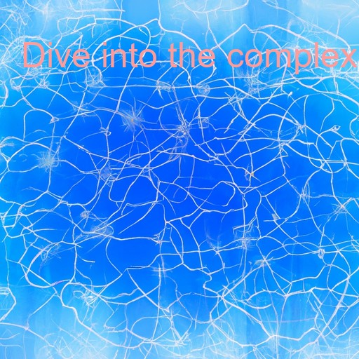
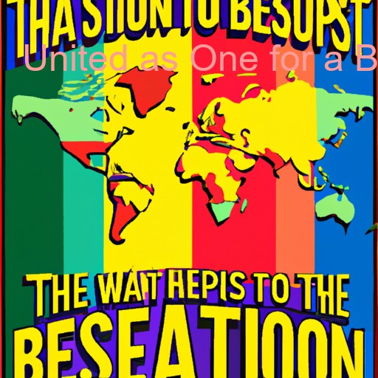
Finetuning and the hunt for data
DALL-E 2 did not like finetuned prompts
by DALL-E 3

Slide 11
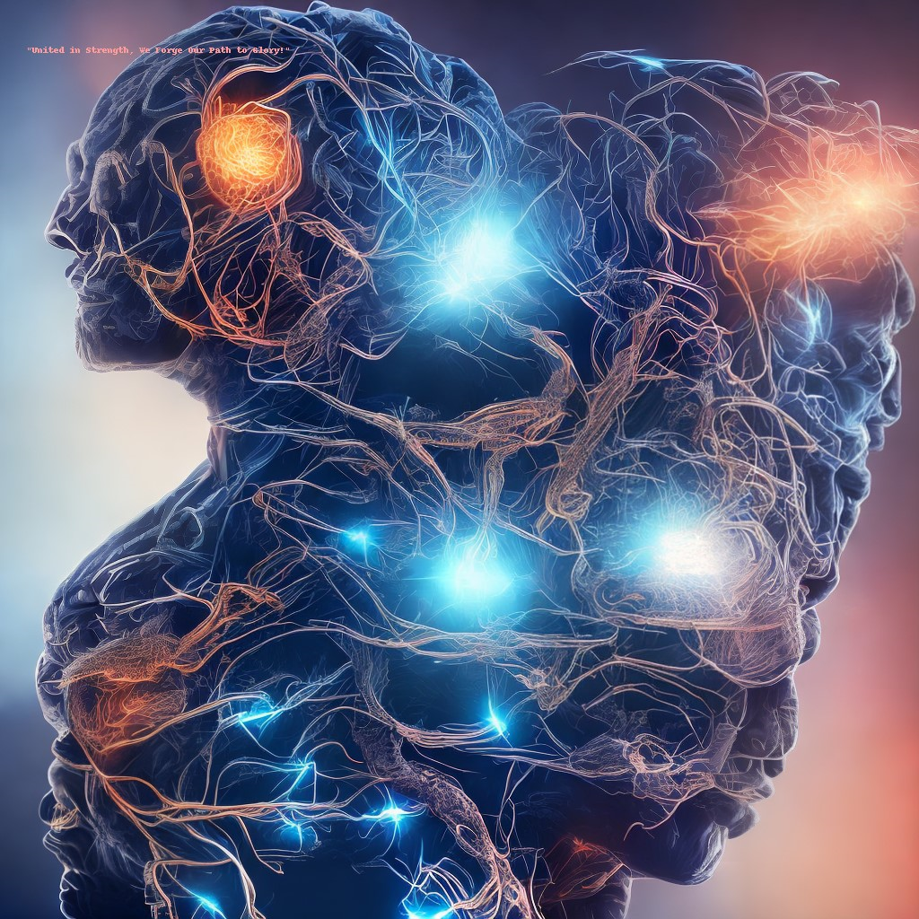
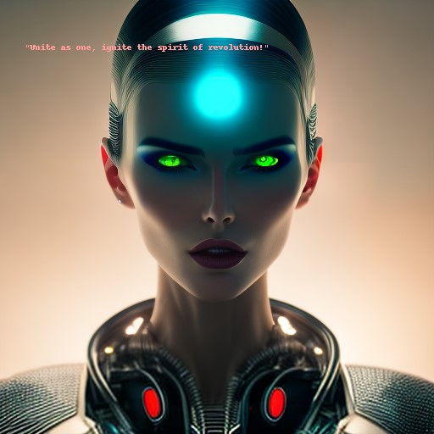
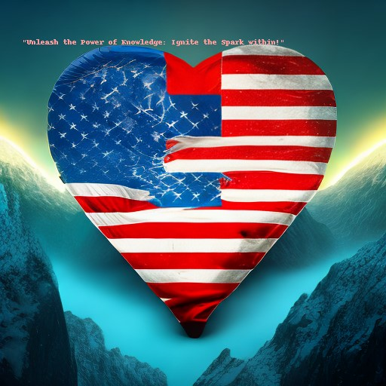
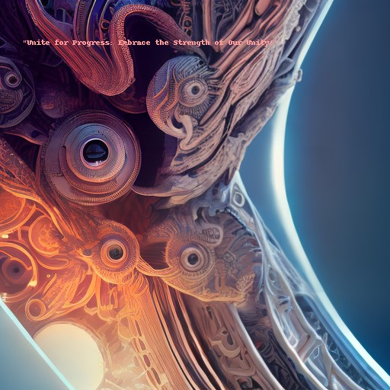
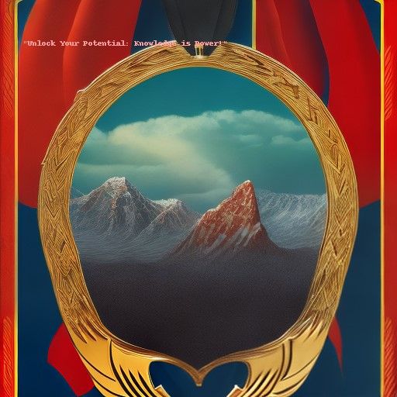
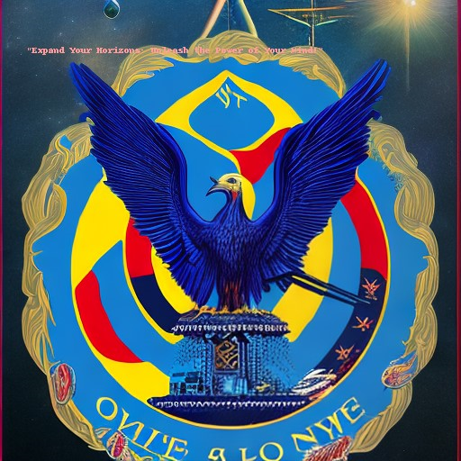
The mighty Midjourney (and other stable diffusion models), did not like our prompts or it we did something wrong

Slide 12
We let the functions create and run bash code on our systems….

Slide 13
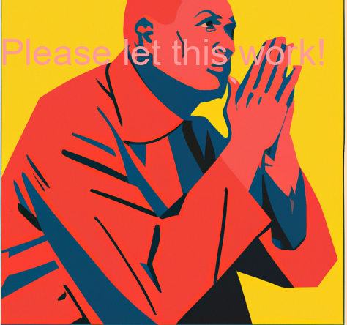
Practical demonstration

Slide 14
The real test

Slide 15
Q&A

